Slide 1
Ecosystem | LifeGame
2016.04.12 pre

Slide 2
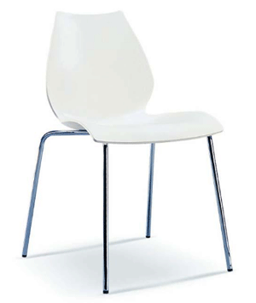
目录
CONTENTS
1
Model
2
Code
3
GUI
4
Conclusion

Slide 3
Details
Code
GUI
Conclusion
cell class
cellMap class
control-functions for GUI
MainWindow
End,restrat dialog
Set,about-us dialog
highlight
deficiency
Complexity Analysis

Slide 4
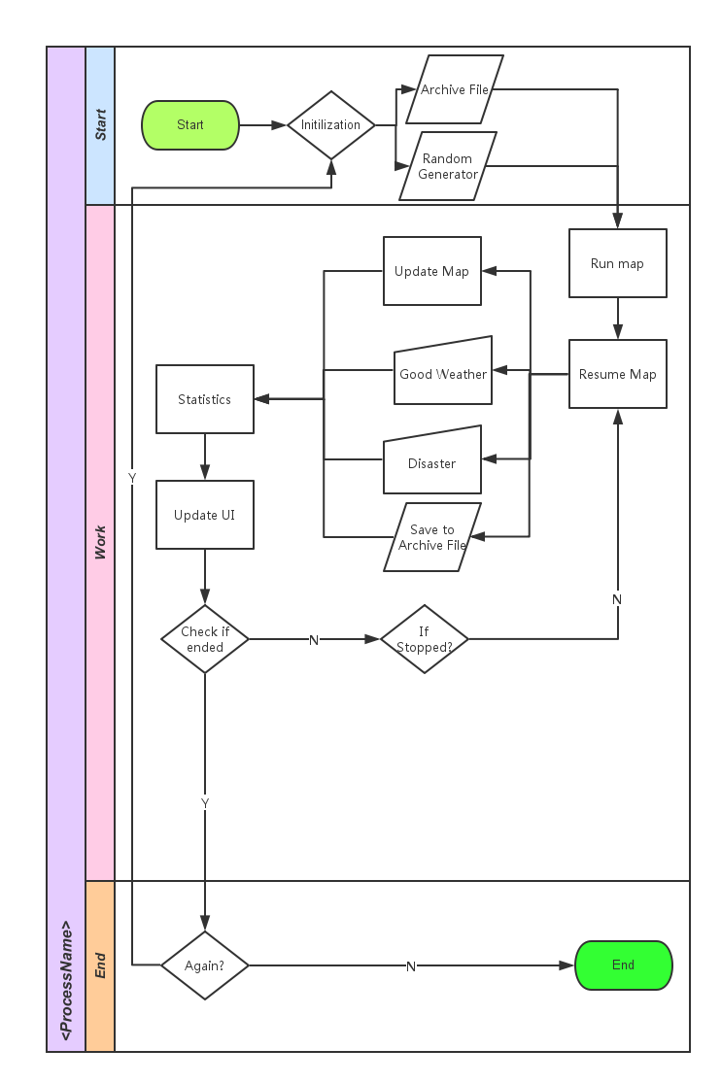
Model Discussion
Notes:
If it is nothing, A new living may be burned. It can be producer, consumer or high consumer. It depends on number of livings around it. It won’t be burned if the number is too high or too low.
For consumer and high consumer, it has a random life expectancy and random limit for starvation. When it reach one of its limit, it will die.
Only consumer will eat producer and only high consumer will eat consumer.
For consumer and high consumer, it will eat all its prey in its releam. It can reduce its starvation.
For consumer and high consumer, if there are too many livings of the same type nearby, they will die from competition.
“Favourable weather” and “Disasters” will reproduce/kill livings.
The system will terminate if all livings die out.
The succession completely depends on seeds if there is no manual intervention.

Slide 5
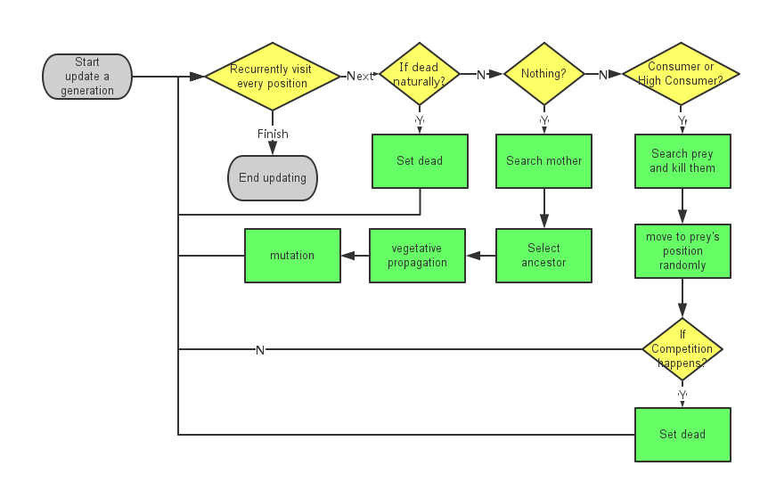
Model Discussion

Slide 6
Back-end Code

Slide 7
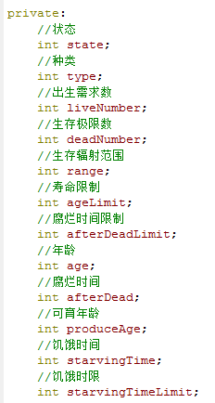
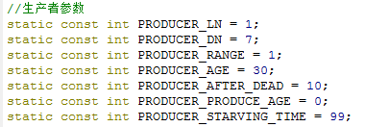
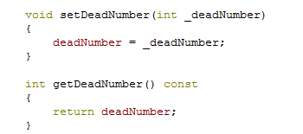
Objects with attributes
12 attributes：
--The class cell shows this part.
Attributes’ get & set functions:
Notes:
Objects with attributes.
The class cell shows this part, in the class, we have 12 private integer member and their get & set functions, we also provide the function of initialization and propagate.
The 12 attributions are state, type, age, age limit, the least burn relations number, the most number in a range with relations, the live range, the grow up age, the have starving time, the longest time for an object that in starving state, the age limit of an object and the time for the corpse become putrid. We add many limits in some get or set functions to make sure the safety of this attributions.

Slide 8
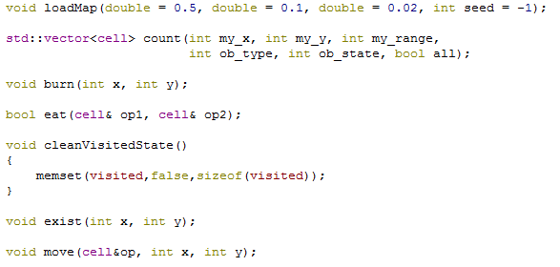
Objects’ actions
--Most of them in class cellMap and others in class MainWindow.
Notes:
Objects’ actions.
We write some objects’ actions in class cellMap and others in class MainWindow, decide by we release in which part is more convenient. Let me introduce them:
Burn: control the burn of the objects, when the function run, it checks the empty spaces of the map, when it finds an empty space, it checks whether there are some objects nearby or not, if yes, then a new object burn by copy the attribution of a random object in the range. When an object is copy, there is a chance (can be controlled by user) that the evolution happened, when it happened, 6 attribution of the object can be changed in a range randomly. (So when you run the program, at last you always see one type objects become crazy as it happens some very useful change and our micro ecosystem is too easy to hold these objects.).
Dead: there are three methods to make an object dead, including dead of age, dead of predation and dead of intraspecific competition.
When an object’s age is larger than or equal to its age limit, it will be dead, and its state become a corpse.
When in an object’s range, there are too many relations, it will happen intraspecific competition, and some objects will be dead.
When an object is eaten by other objects, it will disappear.
What’s more, after an object dead, it will become a corpse and disappear after some time. At the old version, corpse can be eaten by not only other type objects but also the same types, but my teamer thinks it is too cruel, so I deleted this.
Move: When an objects cannot find foods in the range of its current position, it will move and seek the food by search, the method is similar to a limited BFS, in other topic we will have more clearly explain.

Slide 9
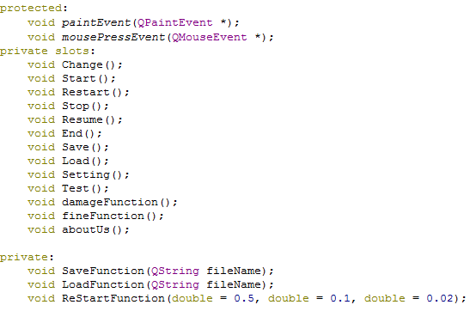
control-functions for GUI

Slide 10
Thread

Slide 11
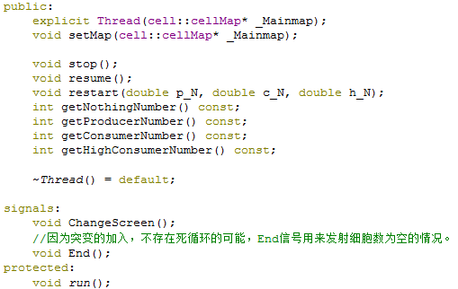
Thread
Notes:
We use thread to let user control the micro ecosystem when it is running. Now I will talk about this:
We let the user options leave in the main thread and we set up a new thread to run our map. In the class Thread we run the map by scanning the objects of map one by one, then collision the information of the micro ecosystem and run the functions of objects’ actions. What’s more, when user do some options in the GUI, it will call some functions in the class Thread to control the objects in the map.

Slide 12
GUI

Slide 13
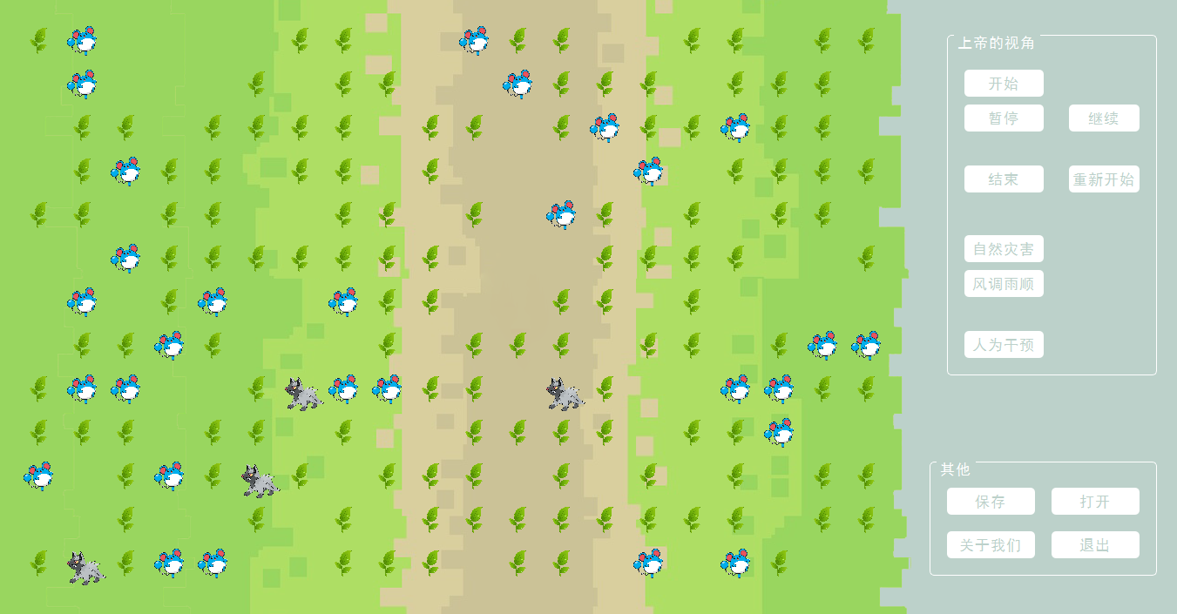
GUI
Main Window
Notes:
GUI include one main window and three control dialog, they are used to relate the options of user and show the micro ecosystem to user.
Main Window.
I show you the style of the main window and explain it to you:
‘start’, ‘pause’, ‘resume’ are design for control the thread so that the user can control the process of the micro ecosystem. ‘damage’ button provides a method that killing some of the objects and ‘fine’ button provides a method to randomly set up some new objects.
‘Save’ and ‘Load’ can save map state and you can run it next time, you need to be careful that do not save the save data in a Chinese name or path, which will lead to the load bug.
‘end’ ‘restart’ ‘setting’ and ‘about us’ will call their dialog.

Slide 14
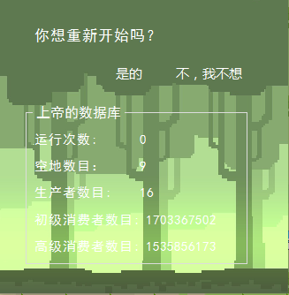
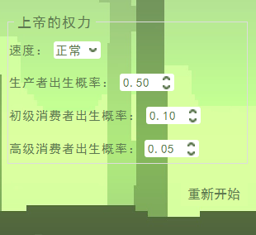
GUI
Dialog for end:
Dialog for reset:

Slide 15
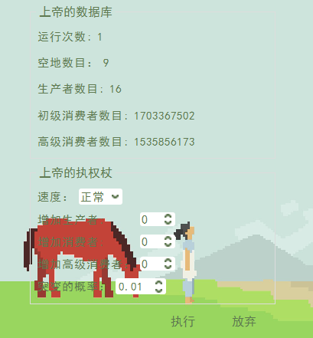
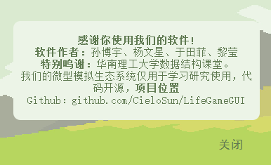
GUI
Dialog for setting:
Dialog for about us：

Slide 16
Conclusion

Slide 17
Highlights
Using the Cellular Automaton Model makes a complication problem easy.
Using thread to control the game proceeding.
Real described the relationship and behavior between species using attributes as few as possible. Also, the user can change the state of this ecosystem as they want and get the information of organisms.
4. Using evolution factor makes the result unpredictable.
5. Humanized interface design

Slide 18
deficiency
After all, the whole system can’t reach a long balance.
Buttons using to change environment factors doesn’t do will.
The number of organisms is small.

Slide 19
Complexity Analysis:
For m*n maps:
O(mn) for map generation, saving and map update.
2. O(mn) for map update, an constant time for range searching, depending on build-in parameters.

Slide 20
2016.04.12 pre
That’s all,
thank you for watching !

